Slide 1
Jupyter Notebook Markdown & Magic Commands

Slide 2
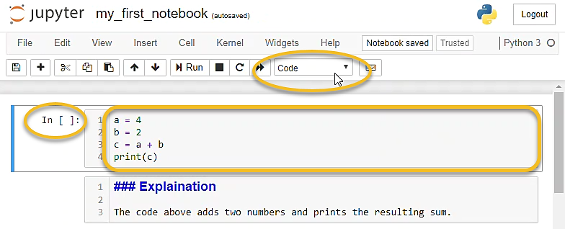
Code Cell
In code cells, we write Python code, then execute the Python code and see the resulting output. An example of a code cell is shown below.

Slide 3
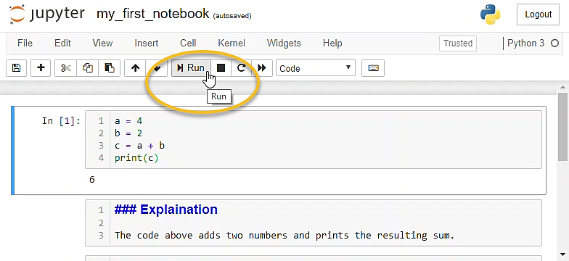
Run code
To run the Python code in a code cell push the [Run] button or type [Shift]+[Enter].

Slide 4
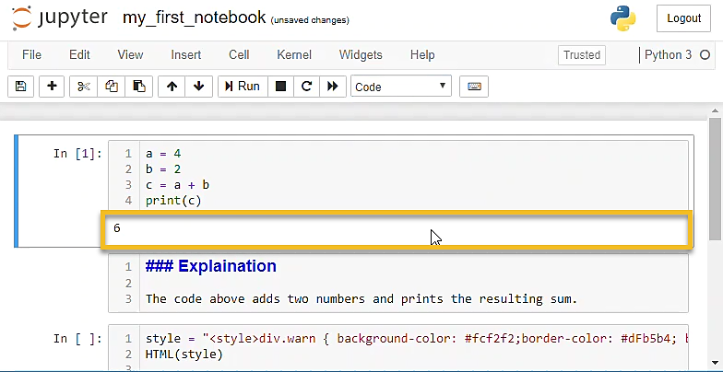
Output Cell
After a code cell is run, an output cell can be produced below the code cell.

Slide 5
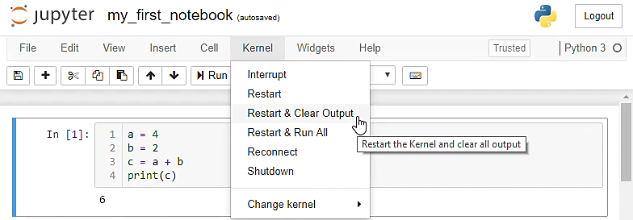
Restart & Clear Output
You can clear all the output cells and re-run code cells by selecting [Kernal] --> [Restart Kernal and Clear Output].

Slide 6
Markdown Cells
Markdown cells don't contain Python code.
Markdown cells contain text written in Markdown format.
Text in markdown cells can be formatted to show bold or italic text.
Tables, images, and lists can also be included in markdown cells.

Slide 7
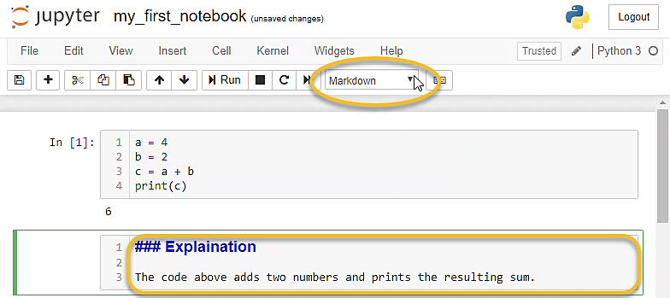
Markdown Cells
Markdown cells are used for documentation and explaining your code.

Slide 8
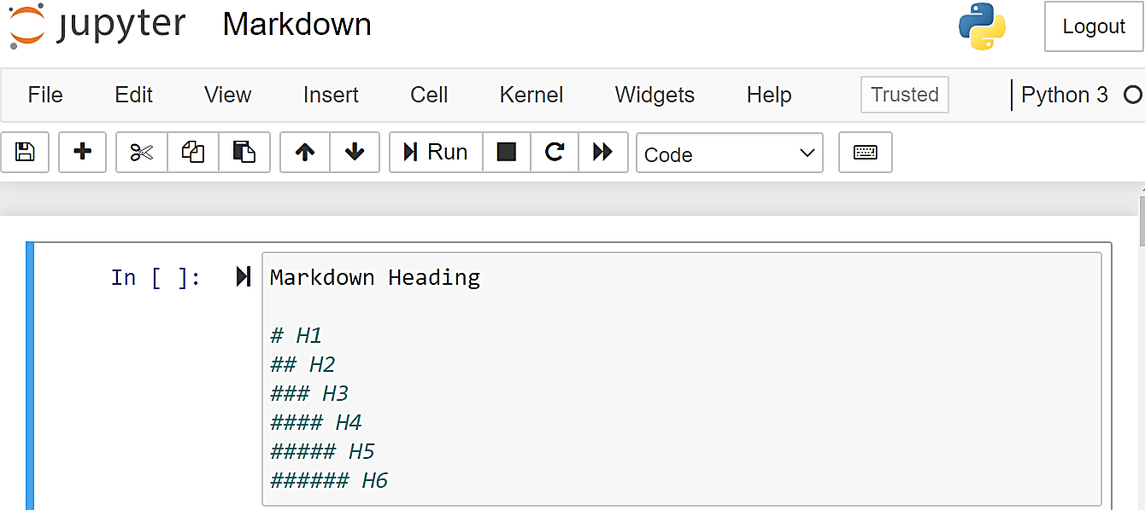
Headings
Headings are created in markdown cells using the hash symbol
One is the largest heading. Four hashes is the smallest heading.

Slide 9
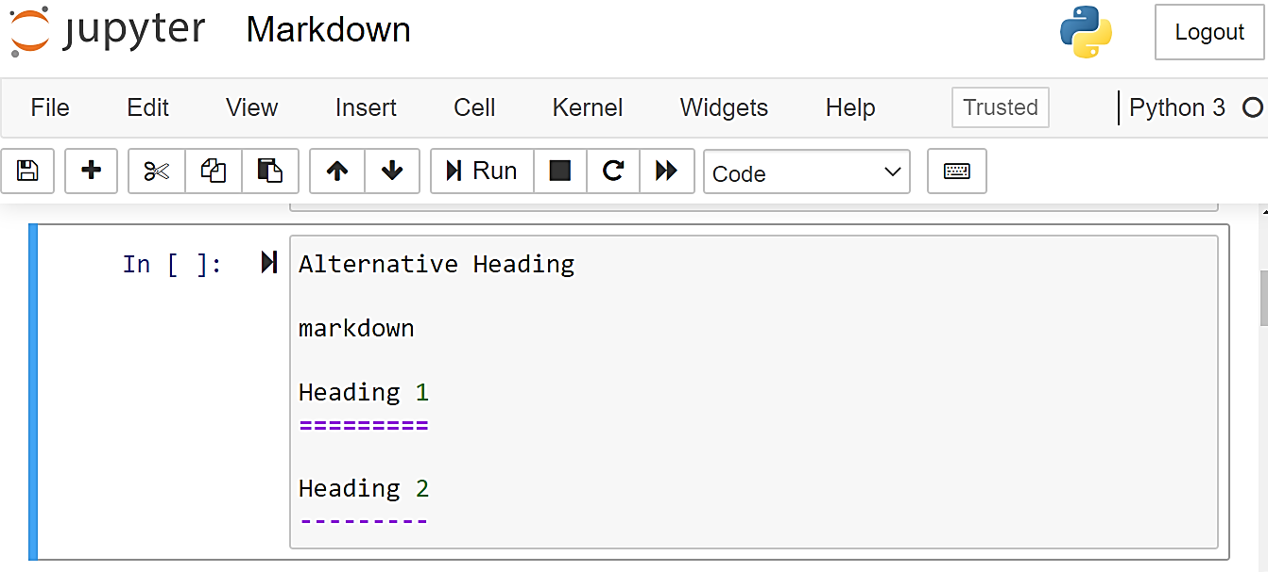
Alternative Headings
Alternatively heading can be created with == & --

Slide 10
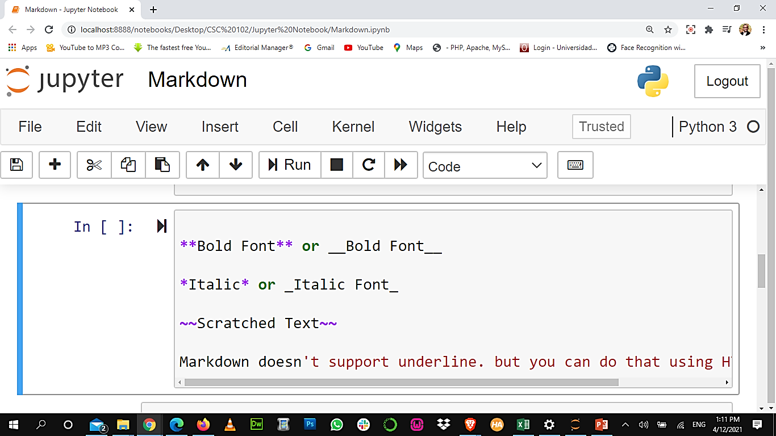
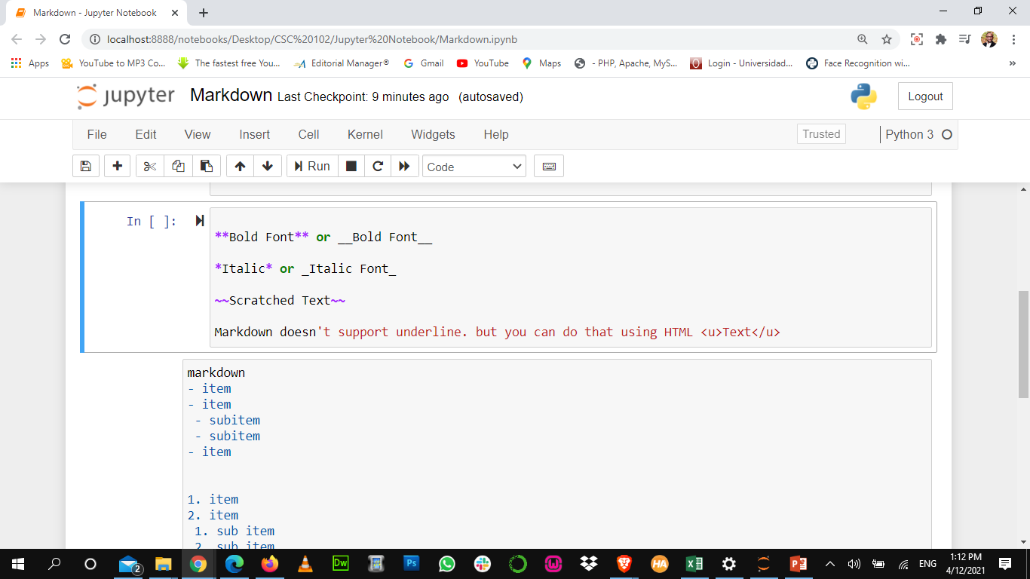
Font Styles
Markdown doesn't support underline. but you can do that using HTML Text

Slide 11
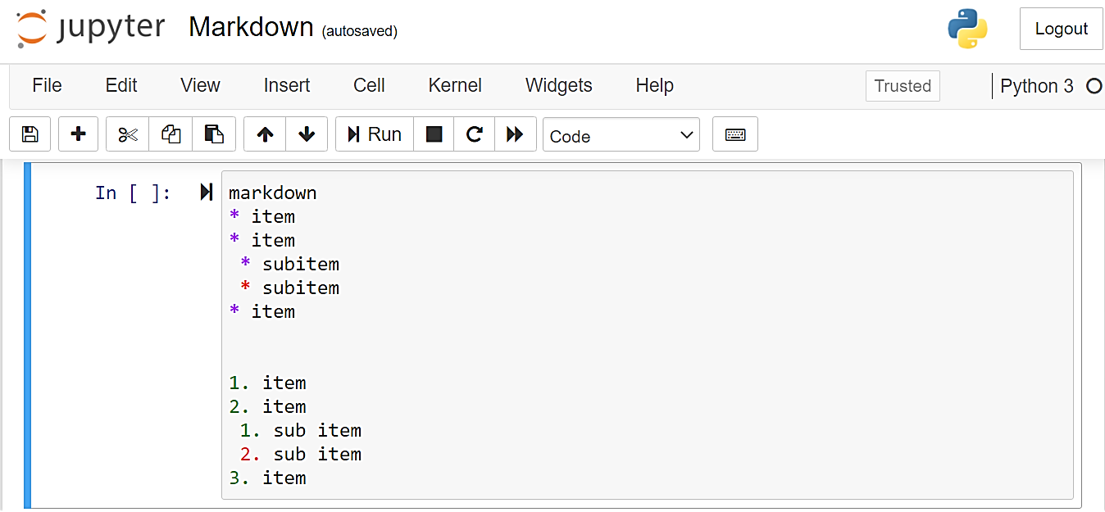
Lists
Bullet points are produced using the asterisk character
Numbered lists are produced using sequential numbers followed by a dot. Indent sub-items with two spaces.

Slide 12
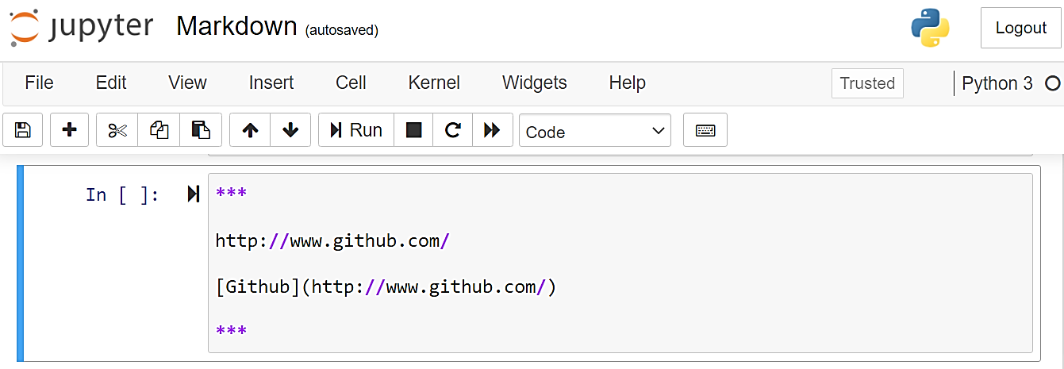
Links & Horizontal Rule
Hyperlinks are specified using a set of square brackets followed by a pair of parenthesis. The text inside the square brackets will be the link, the link address goes in the parenthesis.
A horizontal rule is specified with three asterisks on a single line.

Slide 13
Images
Images are embedded in Jupyter Notebook markdown using the exclamation point and square brackets , followed by the image file path in parenthesis .
If the image can not be displayed, the text in square brackets will be shown.
The image can be in the same directory as the notebook, or a relative path can be specified.
In this case, the image is stored in the directory, which is a subdirectory of the directory the notebook is saved in.

Slide 14
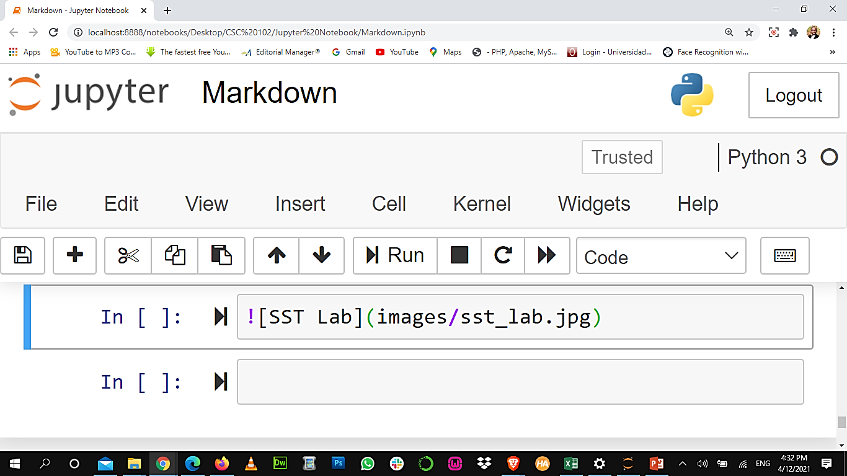
Images

Slide 15
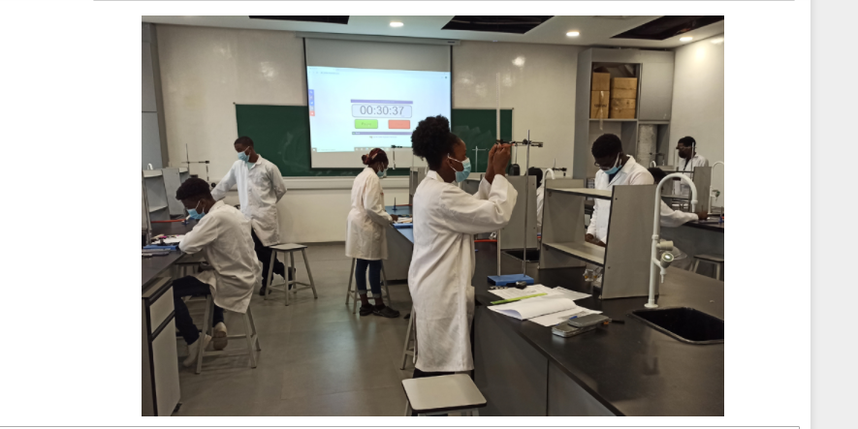
Images

Slide 16
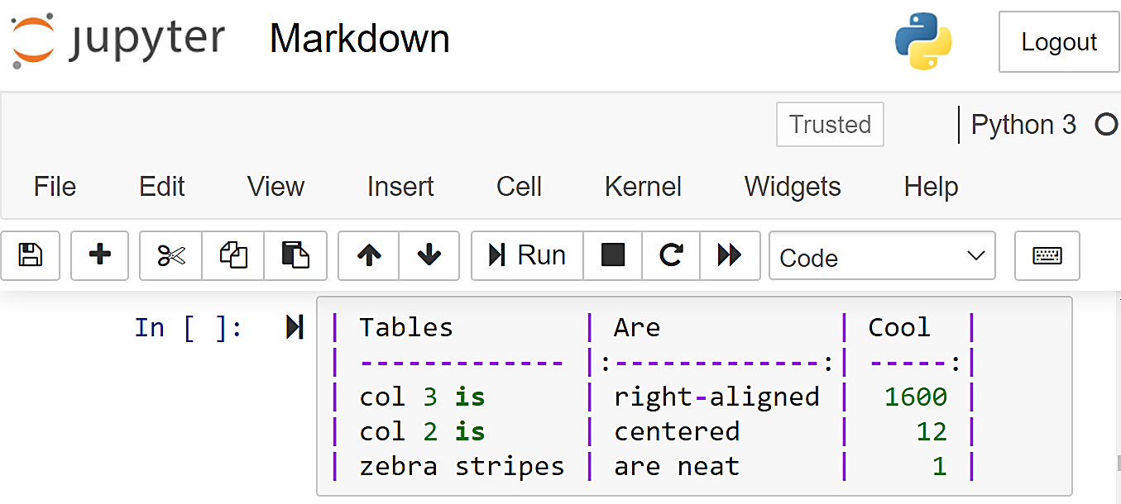
Tables
Tables are displayed using the pipe character, which is + on most keyboards.
Columns are separated by pipes and rows are separated by lines.
After the header row, a row of pipes and dashes are needed to define the table.

Slide 17
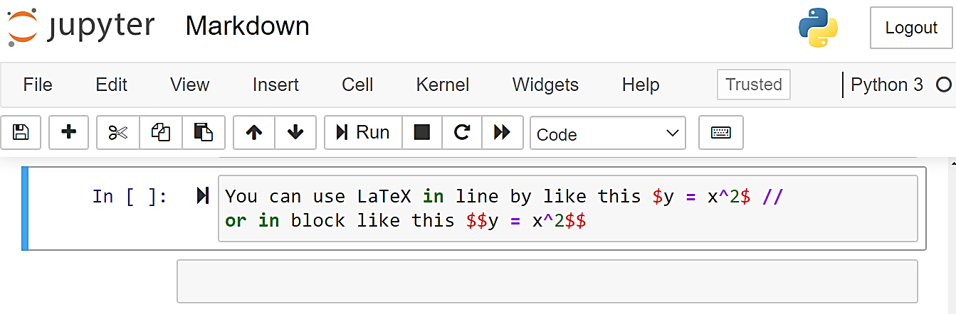
LaTeX
You can use LaTeX in line or in block like this:

Slide 18
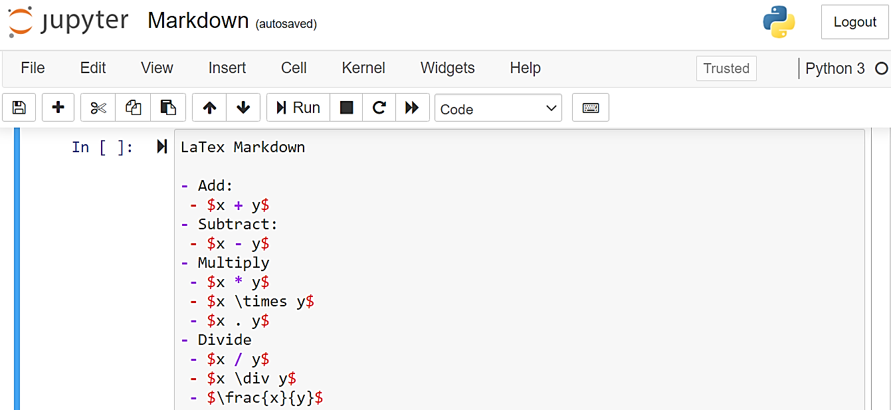
LaTex: Add, Subt, Mult, Div

Slide 19
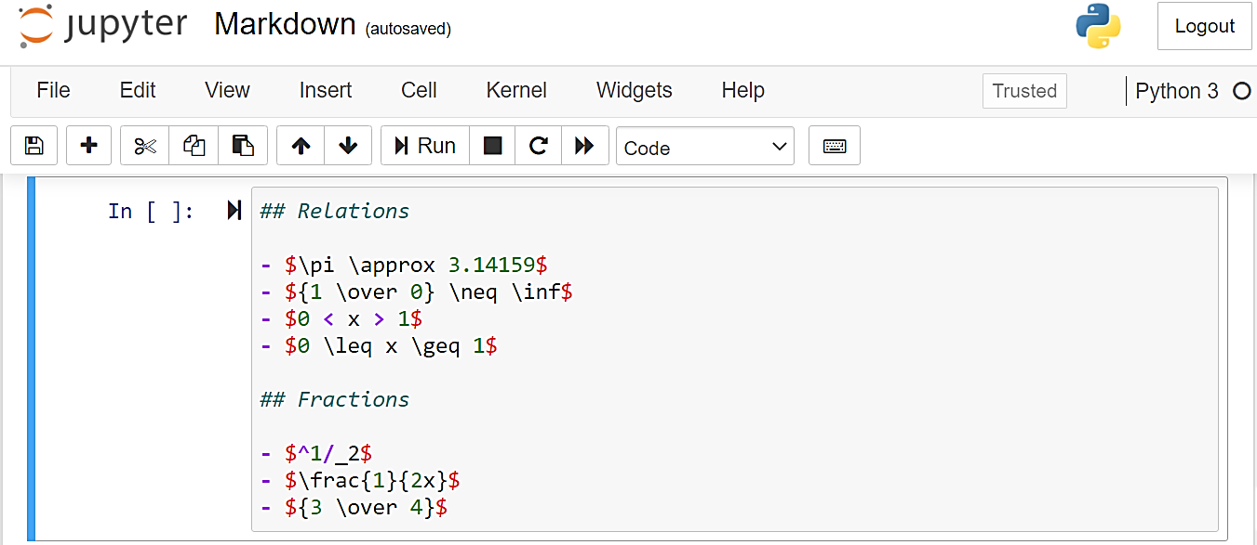
LaTex: Relations & Fractions

Slide 20
Magic Commands

Slide 21
Magic Commands
Jupyter notebook code cells can contain special commands which are not valid Python code but affect the behavior of the notebook.
Let’s start by listing all possible magic commands that you can use in the notebook.
These special commands are called magic commands.

Slide 22
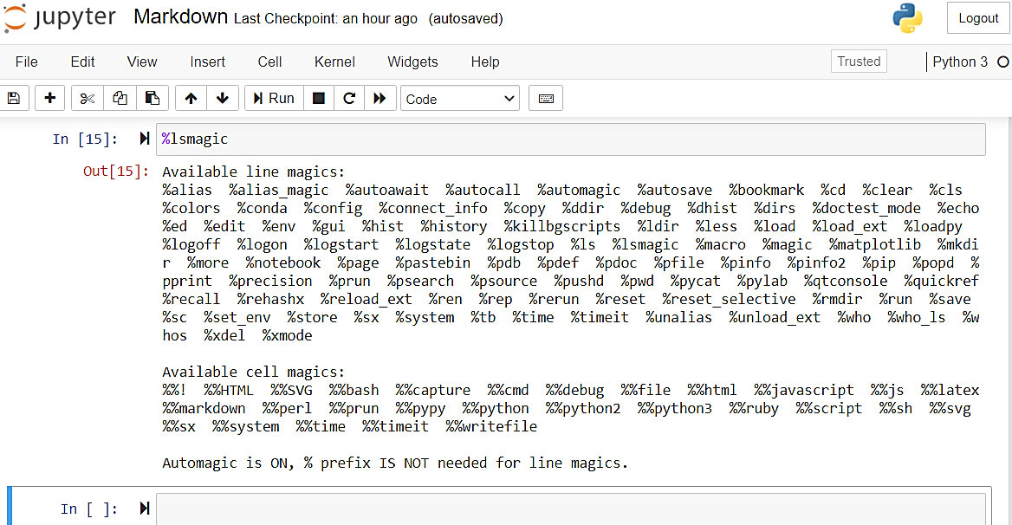
List all magic commands

Slide 23
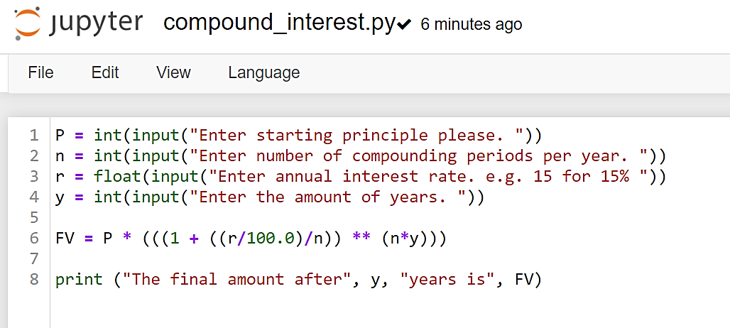
Create a .py file

Slide 24
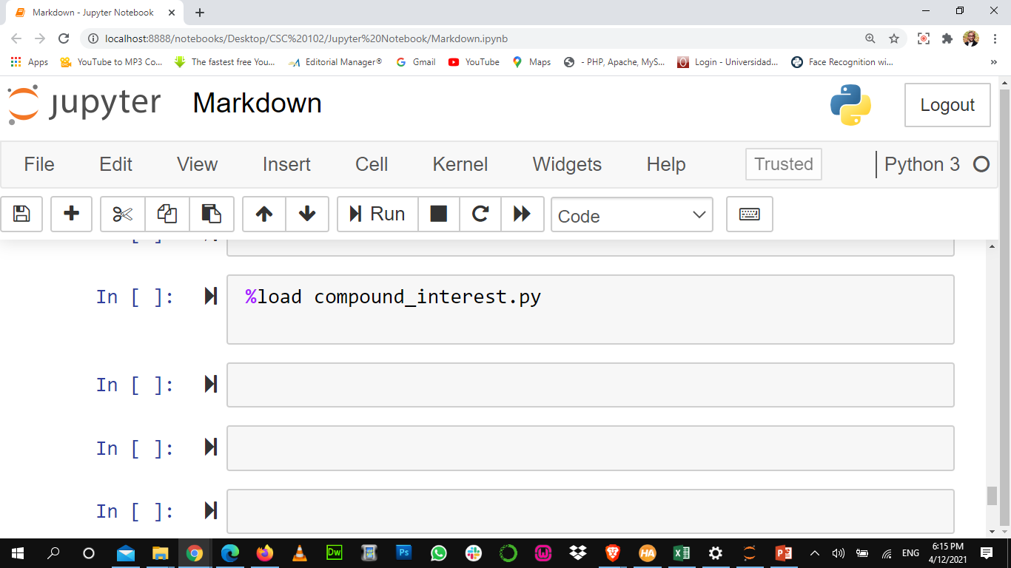
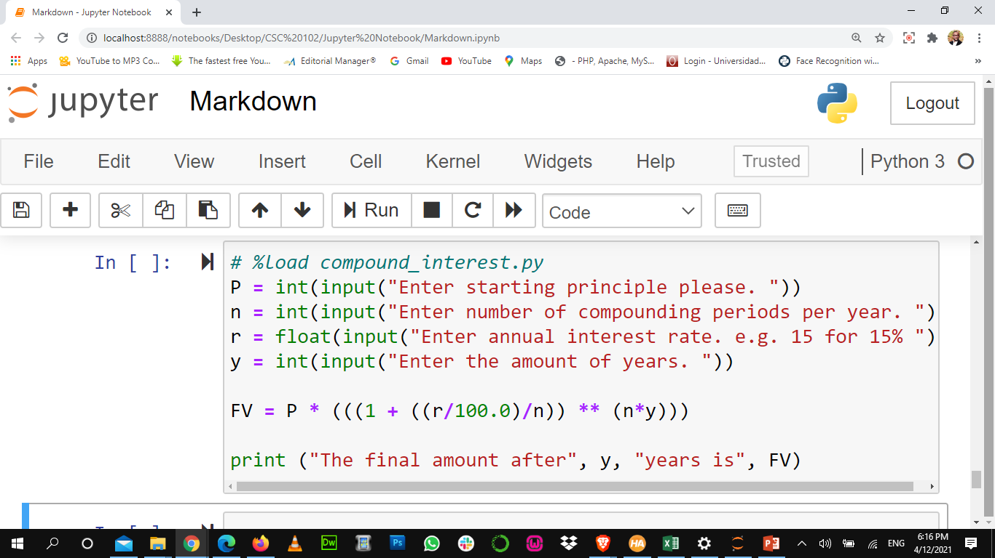
Magic Command: Load a file
You can load an external file to a cell by using the load command.

Slide 25
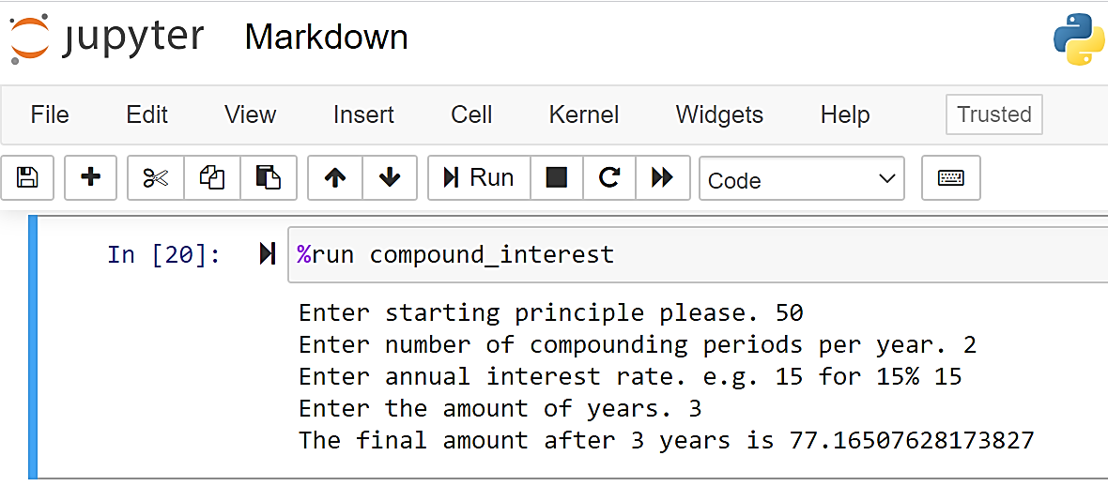
Magic Command: Run a file
You can run a saved file by using the run command.

Slide 26
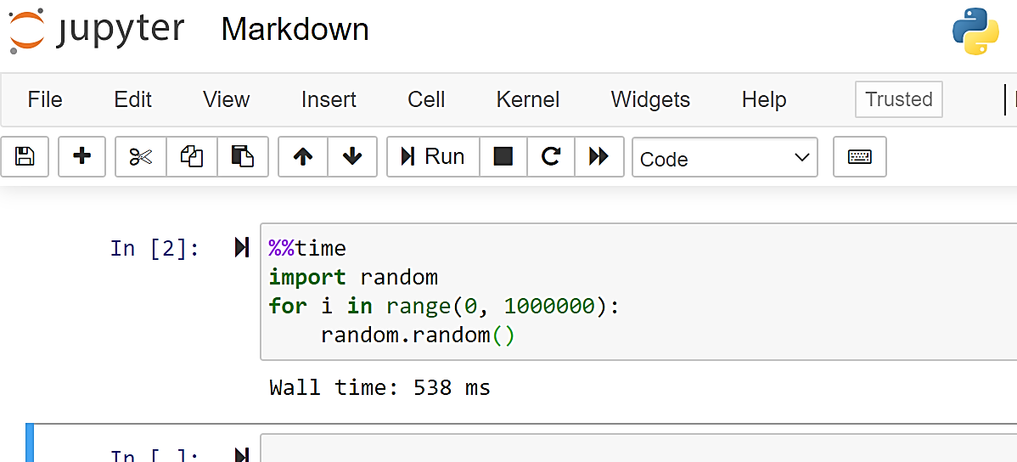
Get an execution time.
You can time the execution of the code using the time command.

Slide 27
Other useful magic commands
Magic Command | Result
%matplotlib inline | Displaying matplotlib graphs in jupyter notebook
%env | Get and set environmental variables.
%pinfo <variable> | Get detailed information about the variable
%pwd | Print the current working directory
%cd | Change the current working directory
%ls | List the contents of the current directory
%history | Show the history of the In [ ]: commands

Slide 28
Class Projects

Slide 29
Instructions
Create a Jupyter Notebook titled “class-projects.ipynb”
Use Markdown to:
Write the code in a cell block
present yourself: Name, Mat. No and Email
create exercise description
Include pictorial representation
Display output
Commit to your GitHub Repository

Slide 30
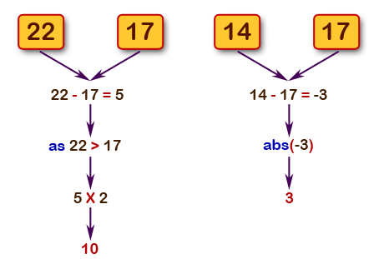
Project I
Develop the algorithm (pseudocode) and python program to get the difference between a given number and 17, if the number is greater than 17 return double the absolute difference.
Pictorial Representation

Slide 31
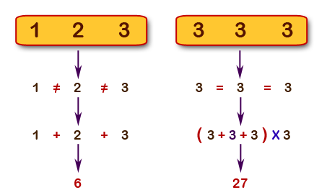
Project II
Develop the algorithm (pseudocode) and python program to calculate the sum of three given numbers, if the values are equal then return thrice of their sum.
Pictorial Representation

Slide 32
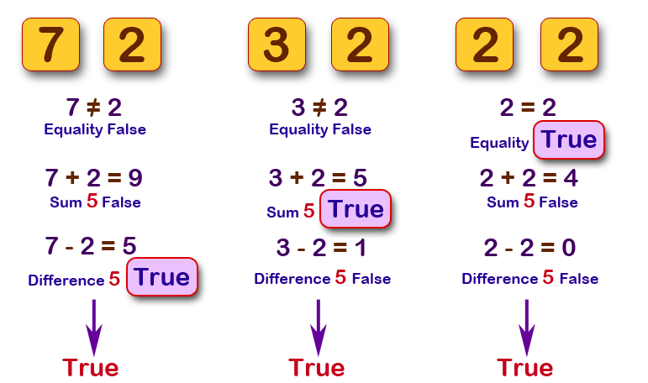
Project III
Develop the algorithm (pseudocode) and python program which will return true if the two given integer values are equal or their sum or difference is 5.
Pictorial Representation

Slide 33
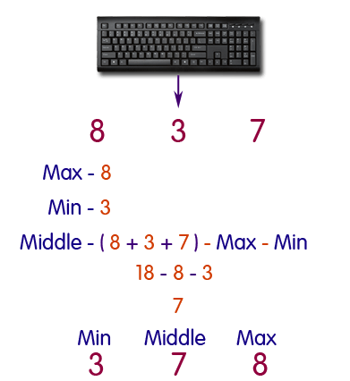
Project IV
Develop the algorithm and python program to sort three integers without using conditional statements and loops.
Pictorial Representation

Slide 34
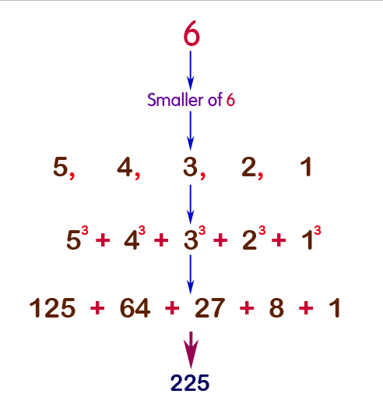
Project V
Develop the algorithm and python function that takes a positive integer and returns the sum of the cube of all the positive integers smaller than the specified number.

